Slide 1
MGMT-6064 PROJECT LEADERSHIP AND MANAGEMENT
Module 6: Ethical Leadership

Slide 2
Objectives
Ethics definition (review)
Factors affecting ethical decision-making
Ethical issue intensity
Kohlberg stages of moral development
Ethics in project management
Creating an ethical project culture
PMI Code of Ethics and Professional Conduct (review)
PMI Framework for ethical decision-making

Slide 3

Recall from other courses: definition of Ethics
Ethics involves judgments about the rightness or wrongness of human behaviour
Includes:
Examination of right, wrong, duty, obligation, rights, justice, fairness, etc.
Values that relate to the nature of human conduct
Rules and principles that guide a society
Notes:
Image: http://business-ethics.com/wp-content/uploads/2015/01/Right-Wrong-Sign.jpg

Slide 4
Factors affecting ethical decision-making
Ethical Decision-Making
Environment: Industry Norms, PESTLE
Organization: Ethics Culture
Person: Moral Development
Situation: Ethical Intensity
Notes:
Source: Schermerhorn, J.R. & Wright, B. (2014). Management (3rd Cdn Ed.). Toronto: Wiley. [p. 114-118)

Slide 5
Person factors: Stages of moral development (Kohlberg)
Postconventional Principle-Centred Behaviour
Stage 6: Act according to internal principles
Stage 5: Live up to societal expectations
Conventional Social-Centred Behaviour
Stage 4: Follow rules, meet obligations
Stage 3: Act consistently with peers, others
Preconventional Self-Centred Behaviour
Stage 2: Make deals for personal gain
Stage 1: Avoid harm or punishment
Notes:
Source: Schermerhorn, J.R. & Wright, B. (2014). Management (3rd Cdn Ed.). Toronto: Wiley. [p. 114-118)

Slide 6
Situation Factors: Issue intensity
Intensity
Ethical Behaviour
Consensus of Wrong: How much agreement is there that this action is wrong?
Probability of Harm: How likely is it that this action will cause harm?
Immediacy of Consequences: Will harm be felt immediately?
Proximity to Victims: How close are the potential victims?
Concentration of Effect: How concentrated is the effect of the action on the victims?
Greatness of Harm: How many people will be harmed?
Notes:
Source: Robbins, S.P., Coulter, M., Leach. E. & Kilfoil, M. (2019). Management (12th Cdn. Ed.). North York, Ontario: Pearson Canada.

Slide 7


Ethics in project management
Unique because:
Project are constrained = budget / schedule / scope pressures
Projects are unique initiatives = new situations, no clear rules or standards
Projects have multiple stakeholders = potential conflict of interests, different priorities
Projects may have ambiguous hierarchies or stakeholder relationships = co-ordination may be informal, roles may not be clearly defined
Projects are temporary = team members may not have established an ethics culture (expectations about ethical behaviour)
Notes:
Image: https://tr1.cbsistatic.com/hub/i/r/2017/01/24/e02bd4a2-ce7c-4ddd-a2dc-48f767a0ce31/thumbnail/770x578/55f6f972c31ac66597fb4f03afef0aa9/ethicsistock-522243743rawpixel.jpg
Text Source: adapted and expanded from
Ljungblom, M. & Lennerfors, T. T. (2018). Virtues and Vices in Project Management Ethics: An Empirical Investigation of Project Mangers and Project Management Students. Project Management Journal, 49(3), 5–16.

Slide 8

Common unethical practices in project management
Moving to execution when testing results are showing large errors
Overcharging project work hours
Accepting gifts from suppliers
Engaging in bribery or kickbacks to clients
Withholding information about possible project issues
Exaggerating the team’s expertise or capabilities
Etc.
Notes:
Image: http://reputationalcompliance.com/wp-content/uploads/2012/03/Ethical-and-Unethical-Business-Practices.jpg

Slide 9

Creating an ethical project culture
Regulation: ethical code, procedures, policies
Promotion: training, raising awareness, access to information, financial disclosure, enhanced communication, use of IT, keep it current (e.g., make it part of team meetings, story-telling)
Reaction: effective post-incident investigation process, harsh penalties (deterrent)
Compliance: compliance to procedures, compliance to contracts, compliance to code of conduct, compliance to professional standards
Notes:
Image: http://research-methodology.net/wp-content/uploads/2020/11/Harrison%E2%80%99s-Model-of-Culture.jpg
Info Source: adapted from Owusu, E. K., Chan, A. P. C., DeGraft, O.-M., Ameyaw, E. E., & Robert, O.-K. (2019). Contemporary Review of Anti-Corruption Measure in Construction Project Management. Project Management Journal, 50, 40–56.

Slide 10
Creating an ethical project culture
Monitoring: auditing/ oversight, contract monitoring, whistle-blowing mechanism, anonymous assistance, independent and efficient reporting systems
Management: transparency, corporate governance, senior management support, professional associations, checks & balances, cultural change if needed, good leadership
Good Leadership includes: being a good role model, training and supervising team, motivation and reinforcement, rewards
Notes:
Image: http://research-methodology.net/wp-content/uploads/2020/11/Harrison%E2%80%99s-Model-of-Culture.jpg
Info Source: adapted from Owusu, E. K., Chan, A. P. C., DeGraft, O.-M., Ameyaw, E. E., & Robert, O.-K. (2019). Contemporary Review of Anti-Corruption Measure in Construction Project Management. Project Management Journal, 50, 40–56.

Slide 11

PMI’s Code of Ethics and Professional Conduct (review)
The code provides structure and guidance that everyone in the profession can and should use to make decisions
Applies to all PMI members and all non-members who:
Hold PMI certification
Apply to commence a PMI certification process
Serve PMI in a volunteer capacity
The current code is based on global research conducted by PMI with project management practitioners and other stakeholders
Notes:
Image: http://images2.pitchero.com/ui/755916/1414588118_0.jpg

Slide 12

Review: Core Value 1 - Responsibility
Aspirational Standards:
Make decisions and take actions based on the best interests of society, public safety and environment
Accept assignments that are consistent with background, experience, skills and qualifications
Do what we say we will do
Take ownership of errors or omissions and make corrections promptly
Protect proprietary or confidential information entrusted to us
Uphold this Code and hold each other accountable to it
Mandatory Standards:
Regulations and legal requirements
Ethics complaints
Notes:
Image: https://tse2.mm.bing.net/th?id=OIP.XkPNgsCQepFO23vAFSyMdQHaHa&pid=Api&P=0&w=300&h=300

Slide 13

Core value 2: Respect
Aspirational Standards:
Understand cultural norms and customs; avoid engaging in behaviours that may be considered disrespectful
Listen to others’ points of view
Directly approach people with whom we have a conflict or disagreement
Act professionally
Mandatory Standards:
Negotiate in good faith
Do not try to influence decisions or actions of others to benefit personally at their expense
Do not act in an abusive manner toward others
Respect the property rights of others
Notes:
Image: https://sandholevets.co.uk/content/generated/content/centre/Sandhole_Values_Icons-Respect_1000_975_80.jpg

Slide 14
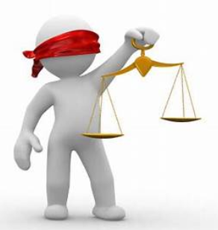
Core value 3: Fairness
Aspirational Standards:
Demonstrate transparency in decision-making processes
Constantly maintain impartiality and objectivity
Provide equal access to information to authorized persons
Make opportunities equally available to qualified candidates
Mandatory Standards:
Conflict of Interest
Favouritism and discrimination
Notes:
Image: https://www.mergersandinquisitions.com/wp-content/uploads/2011/01/fairness_opinions.jpg

Slide 15

Core value 4: Honesty
Aspirational Standards:
Seek to understand the truth
Be truthful in communications and conduct
Provide accurate information in a timely manner
Make commitments and promises in good faith
Create an environment in which others feel safe to tell the truth
Mandatory Standards:
Do not engage in or condone behaviour designed to deceive others
Do not engage in dishonest behaviour with the intention of personal gain or at the expense of another
Notes:
Image: https://ministrytoyouth.com/wp-content/uploads/2016/06/youth-group-lesson-on-honesty.jpg
Source: PMI

Slide 16
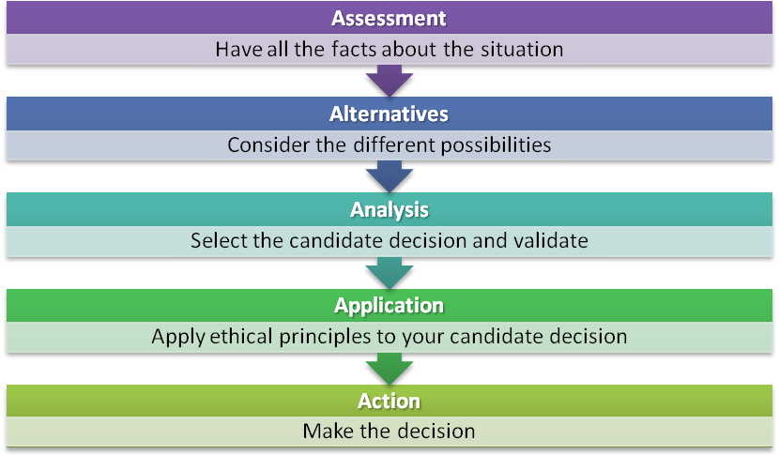
PMI’s Ethical Decision-Making Framework
Guide for ethical practice
Complements Code of Ethics and Professional Conduct and promotes critical thinking about ethical issues
Framework consists of five steps
Notes:
Source: PMI

Slide 17
Optional videos
Space Shuttle Challenger Disaster: Ethics Case Study
Theranos – Silicon Valley’s Greatest Disaster

